Slide 1
QG omega equation lab 2 parts: idealized, and data
Brian Mapes
ATM 407
Fall 2021

Slide 2
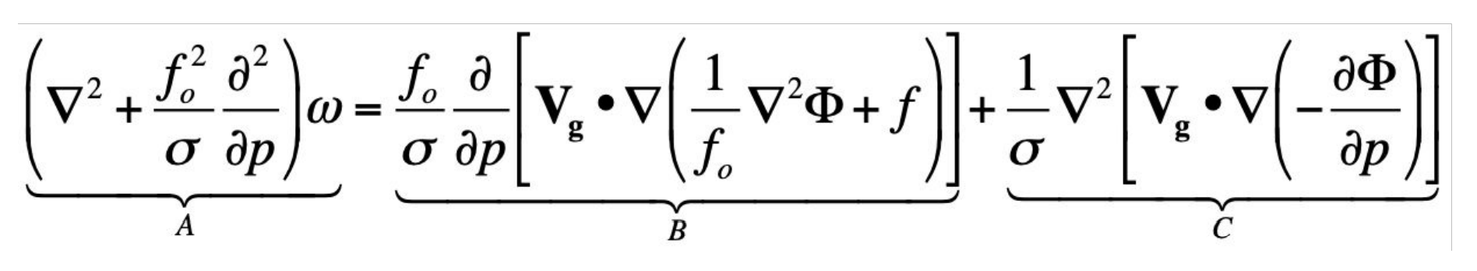
Derivations and maths
https://en.wikipedia.org/wiki/Omega_equation
https://snowball.millersville.edu/~adecaria/ESCI343/esci343_lesson02_QG_tendency_eqn.pdf
2

Slide 3

Part I: COMET/MetEd
Here is a nice tool for viewing the classic “wave” view of the QG omega equation. Give it a look – notice that hovering over equation terms lights up the names for them, or vice versa.
https://www.meted.ucar.edu/labs/synoptic/qgoe_sample/

Slide 4
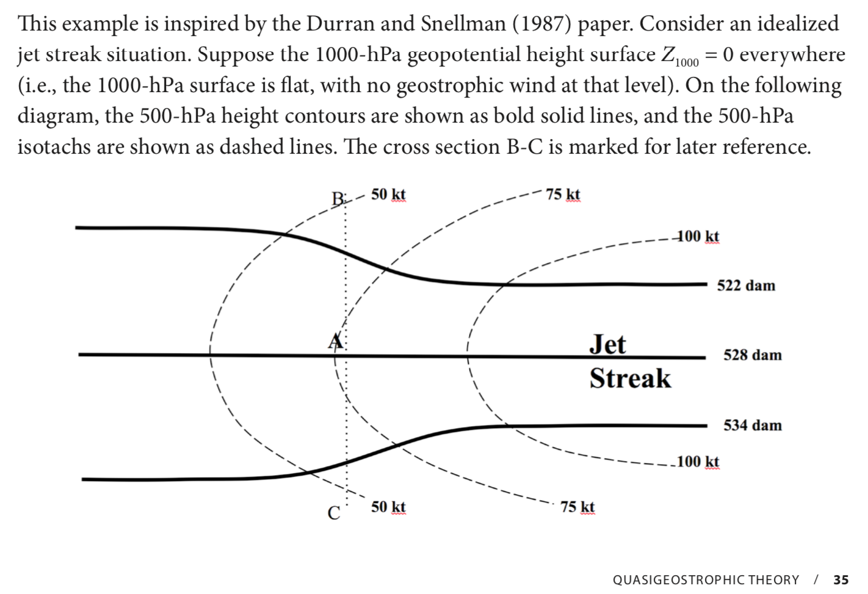
Part II: From the LMT lab book

Slide 5
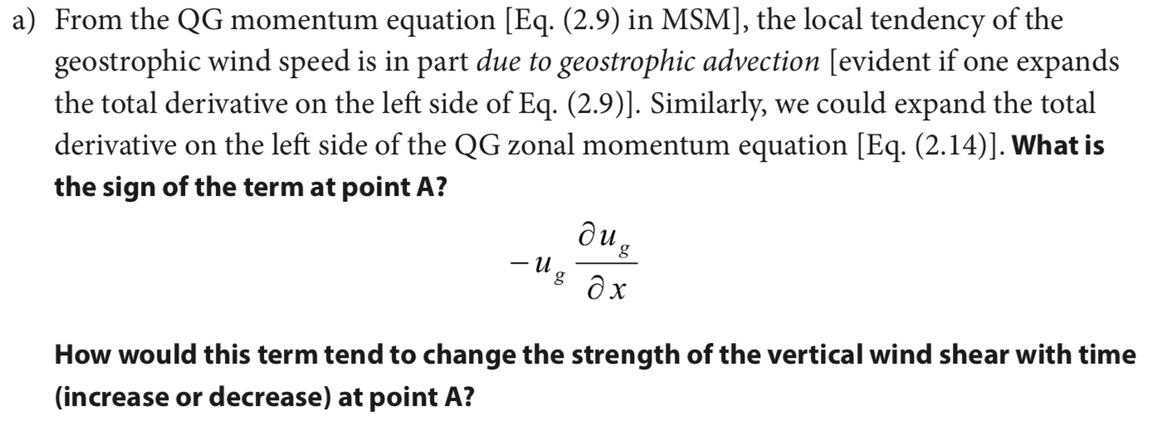

Slide 6
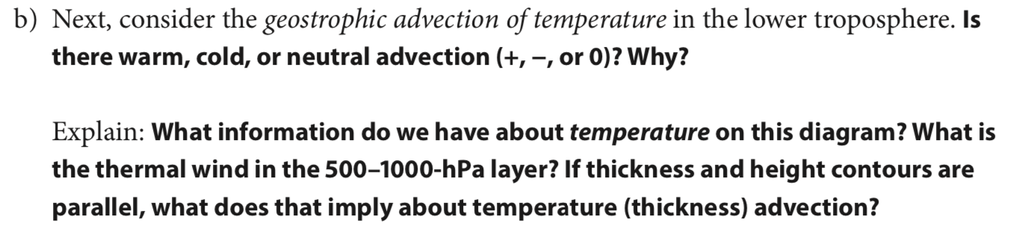

Slide 7
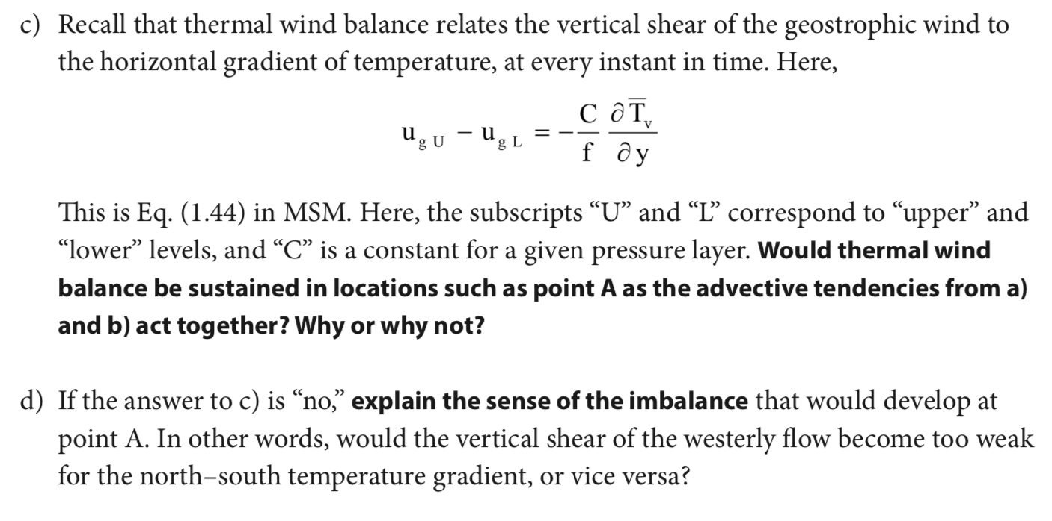

Slide 8
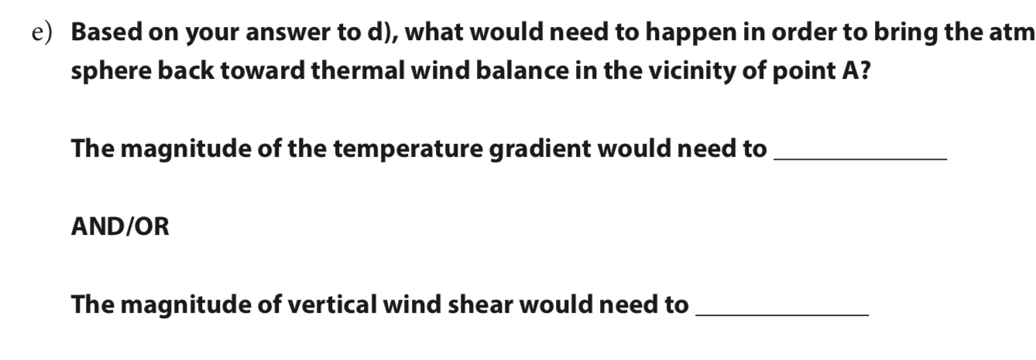

Slide 9
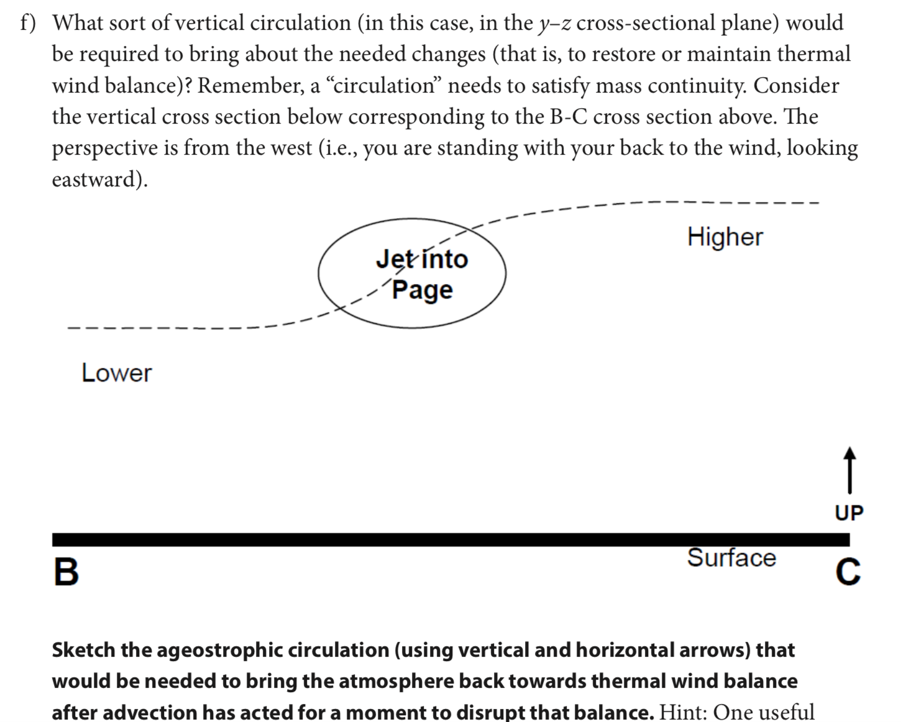
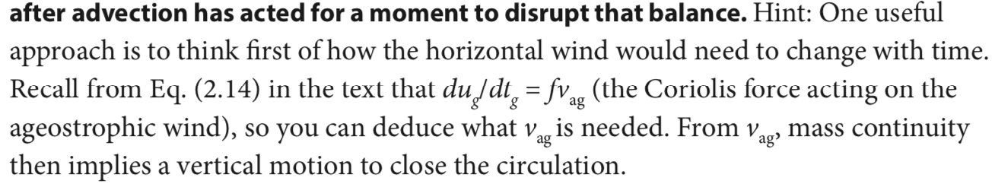
Part I: COMET/MetEd
North
South

Slide 10
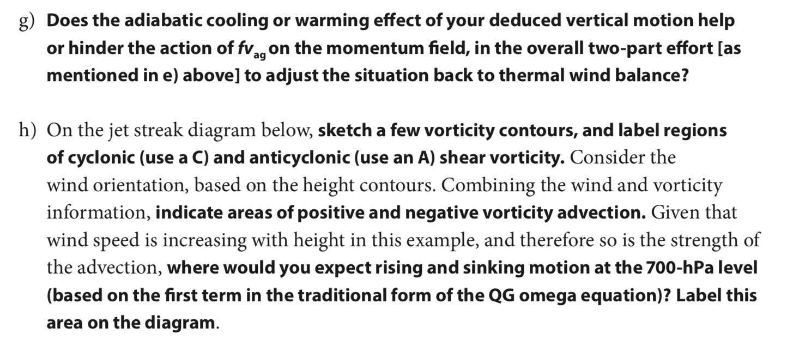
Part I: COMET/MetEd

Slide 11
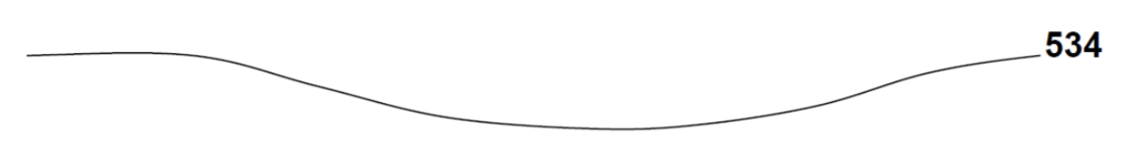
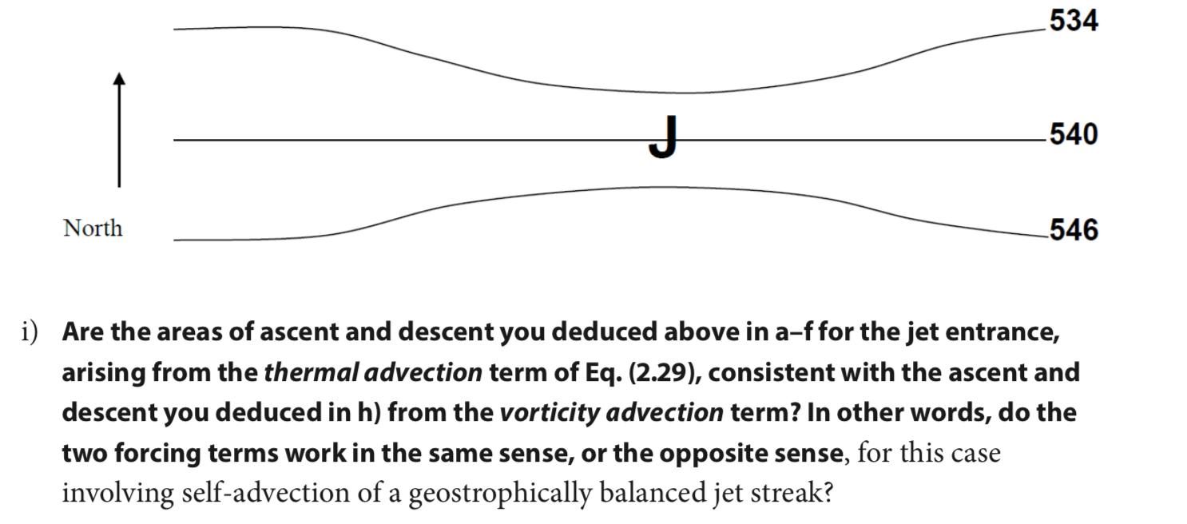
Sketch here with mouse
It’s just a trough

Slide 12
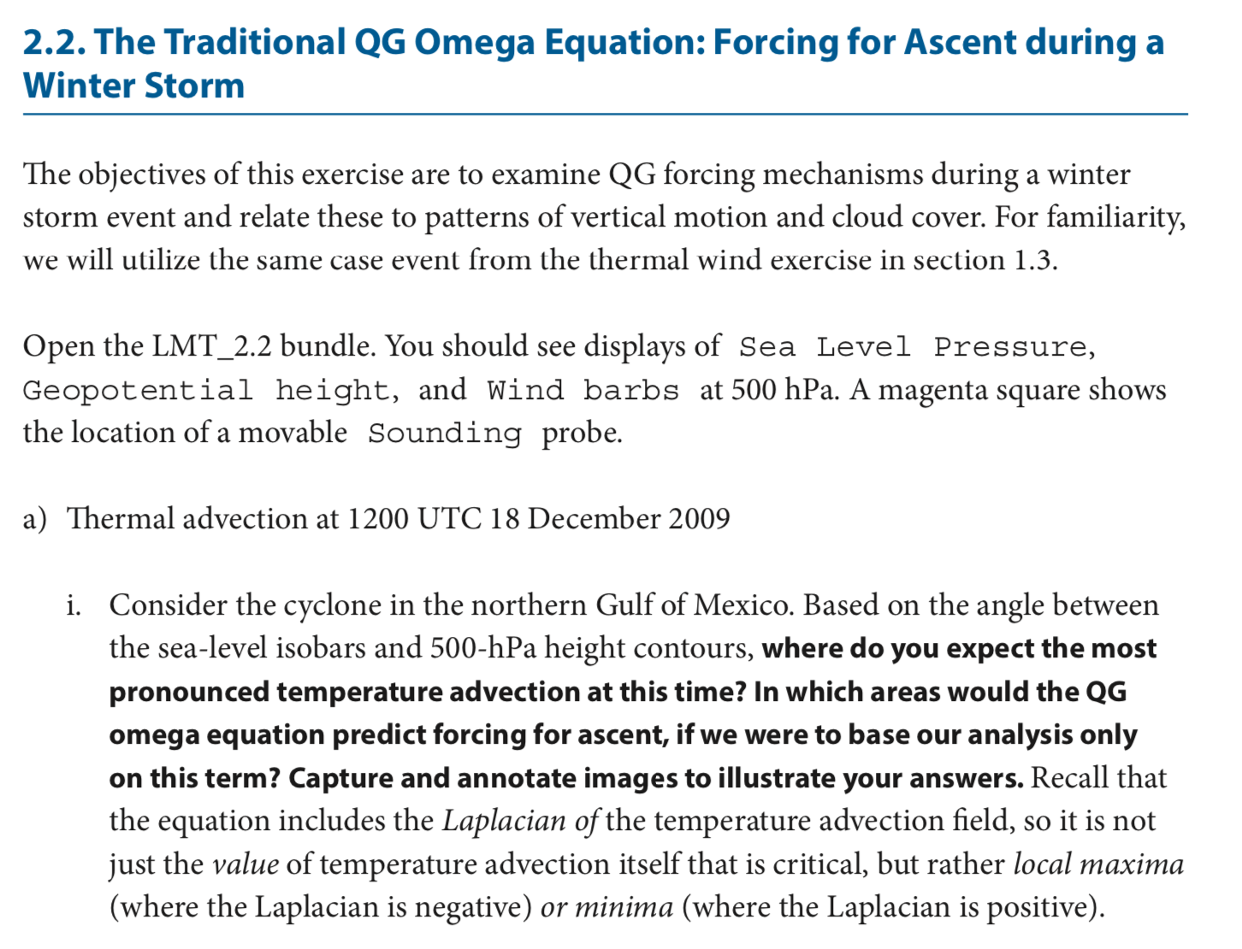
LMT2.2
Launch IDV
← From toolbar folders (there is triple redundancy) find LMT_2.2

Slide 13
LMT 2.2

Slide 14
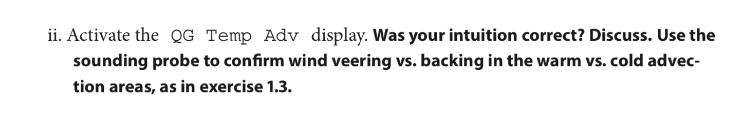
LMT 2.2

Slide 15
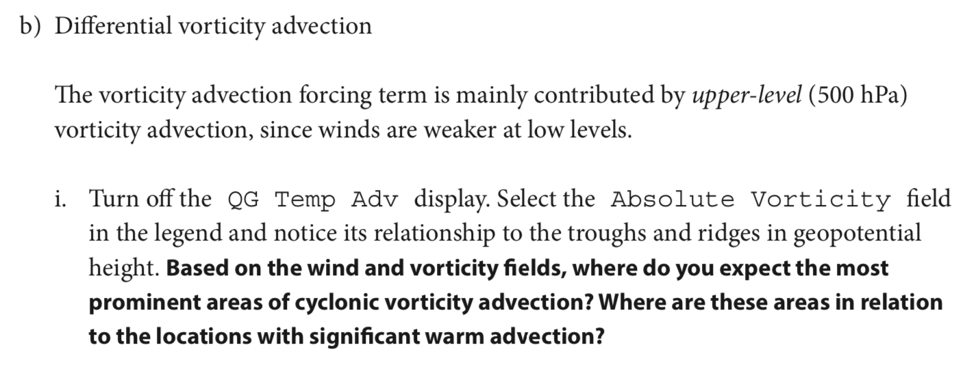
LMT 2.2

Slide 16
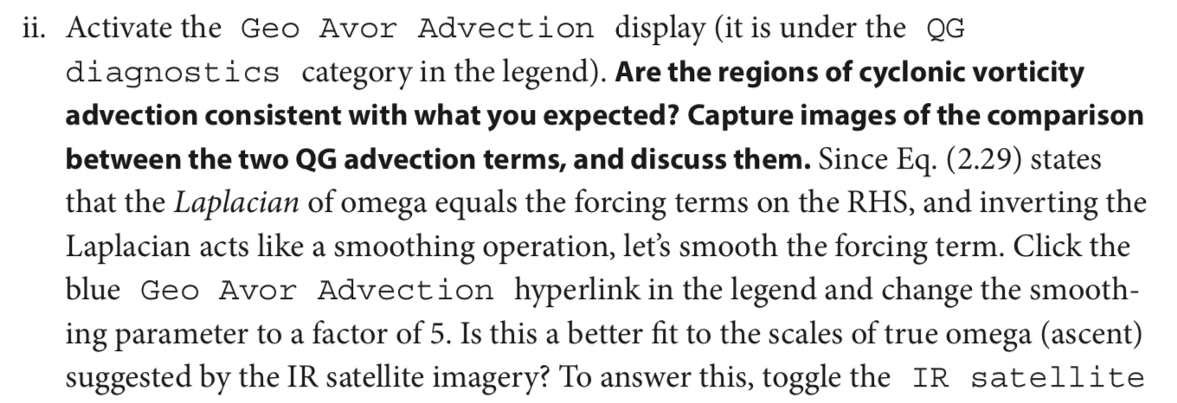
LMT 2.2

Slide 17
LMT 2.2

Slide 18
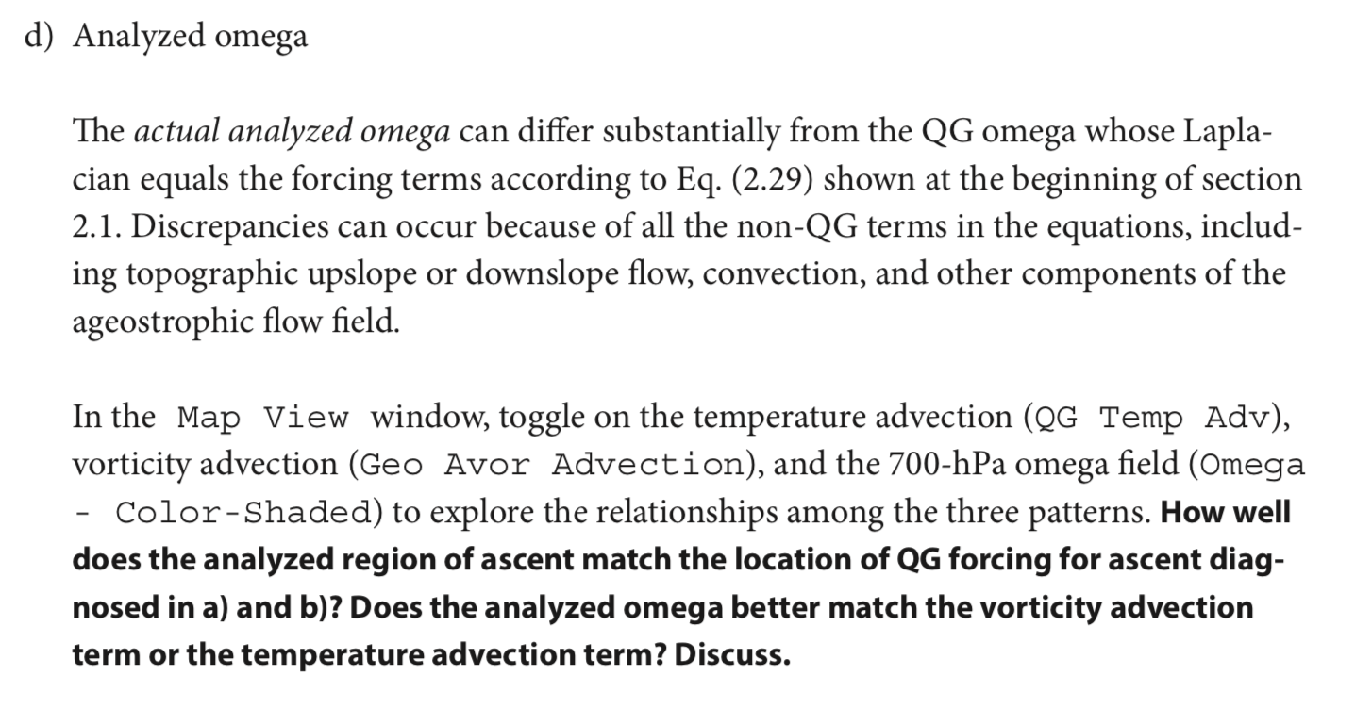
LMT 2.2

Slide 19
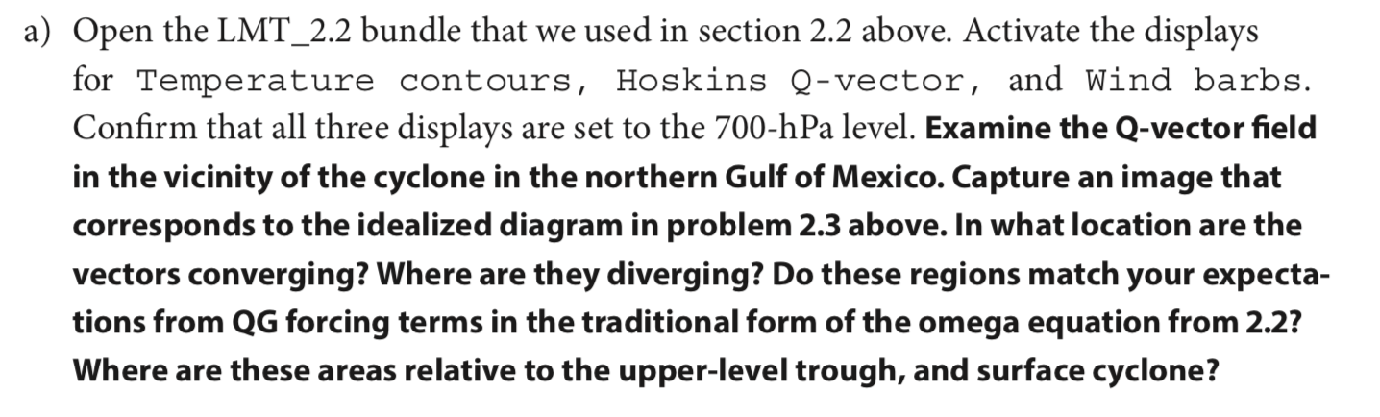
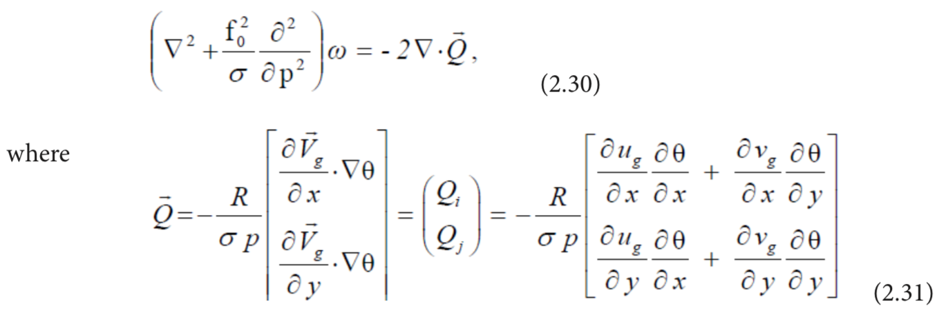
LMT 2.4 (same IDV bundle)

Slide 20
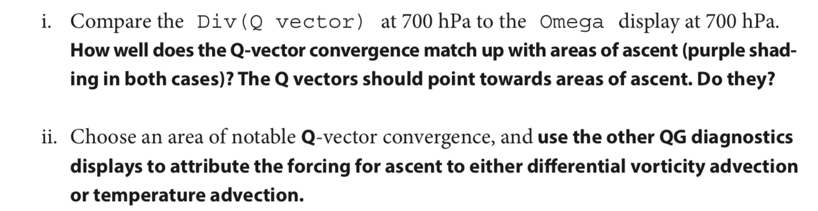
LMT 2.4 (same IDV bundle)

Slide 21
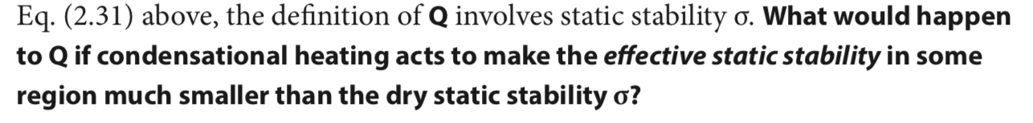
LMT 2.4 (same IDV bundle)

Slide 22
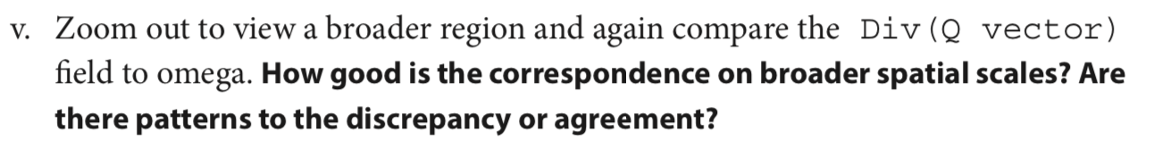
LMT 2.2

Slide 24
BACKGROUND ON QE OMEGA EQUATION

Slide 25
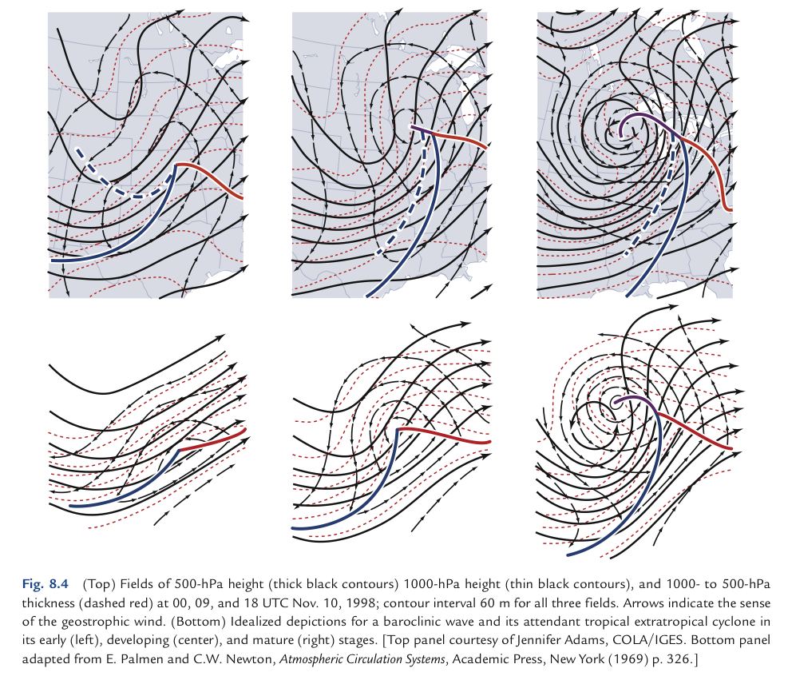
Wallace Hobbs ch8 case:
1969 textbook:

Slide 26
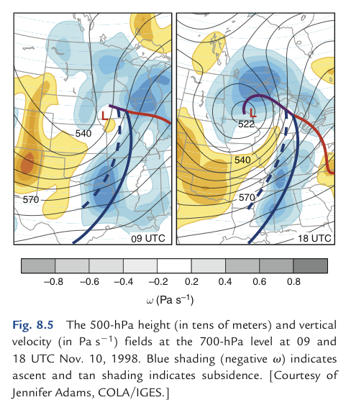
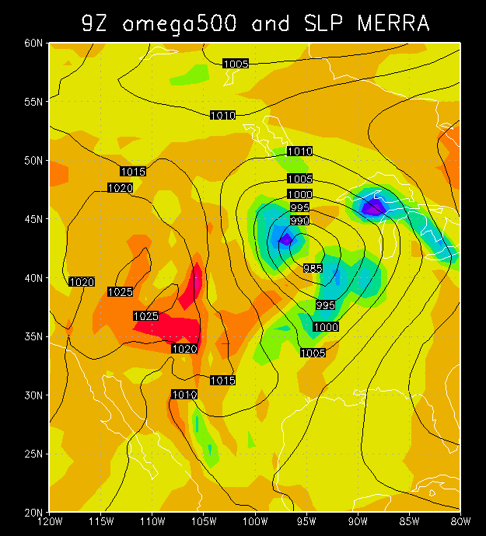
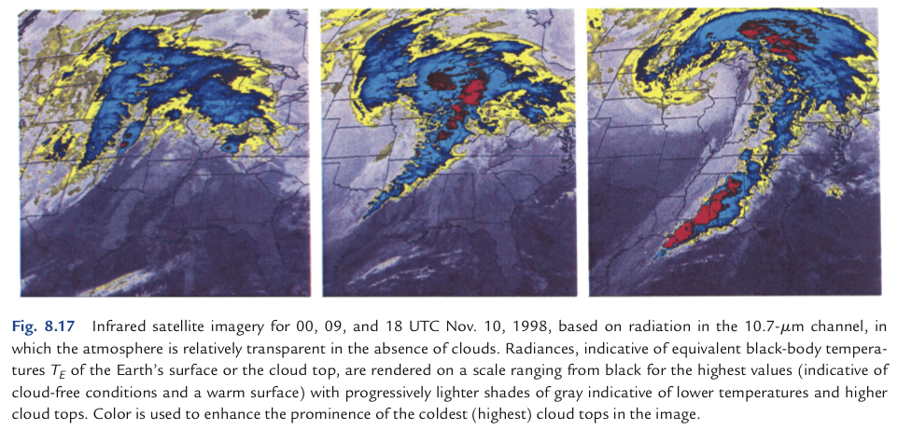

Slide 27
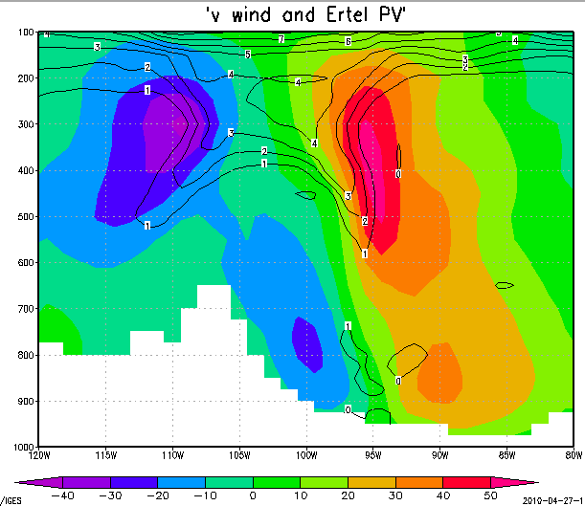

Slide 28
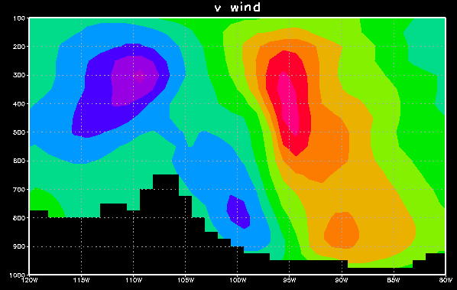
wind out of page
wind into page
cyclonic
(Trof on map)
cyclonic
Rockies
sfc Low

Slide 29
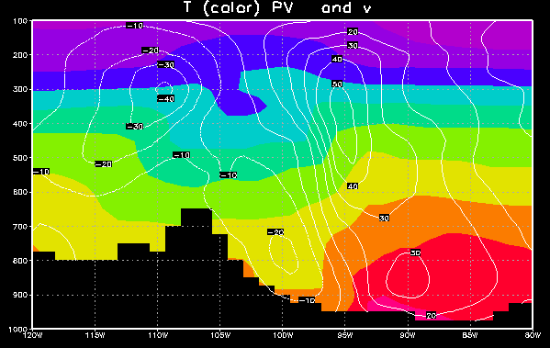
Meridional T advection
cooler air flowing south
warmer air flowing north
Low

Slide 30
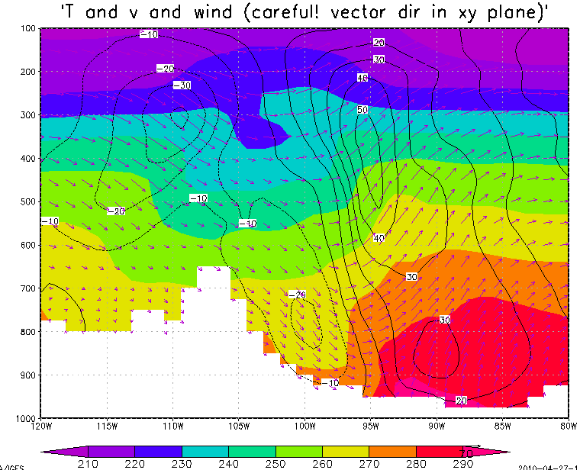
Veering/backing and T advection
TROF
winds backing with height
winds veering with height
cool air flowing south
cool air flowing south
warm air flowing north
warm air flowing north
Low

Slide 31
The omega equation
Why is there upward motion ahead of these upper-level troughs/ cyclonic vortices?

Slide 32
The omega equation
Why is there upward motion ahead of these upper-level troughs/ cyclonic vortices?
A: In order to maintain thermal wind balance, which holds across time, and thus we know logically it has a maintenance mechanism, as advection would tend to break the balance which holds at any one instant
Main mechanism: cooling by upward motion in a stratified fluid.

Slide 33
v and T: thermal wind balance
warm core above
cyclonic
(Trof)
cold core = low thickness
warm core
cyclonic
Low

Slide 34
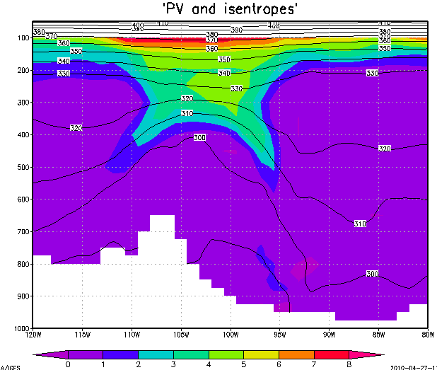


cyclonic ζ
(Trof)
Thermal wind balance prevails: There is a Z trough (trof) for geostrophic balance, with a cold core beneath it, supporting it hypsometrically (in hydrostatic balance).

Slide 35

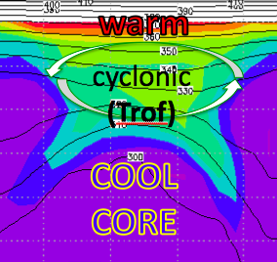

Unsheared advection of T, u, v, vort, PV:
no problem, whole structure moves
cyclonic
(Trof)

Slide 36


Sheared advection breaks thermal wind balance
cyclonic ζ
(Z trof)

Slide 37


Sheared advection breaks thermal wind balance
Z Trof

Slide 38
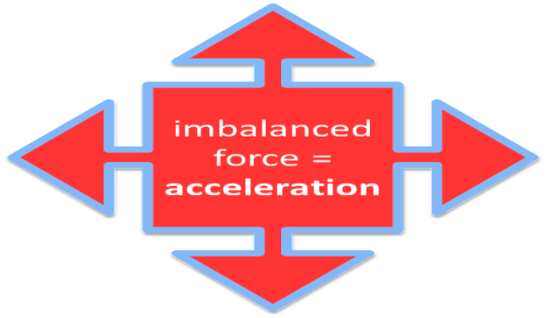
Sheared advection breaks thermal wind balance
Z Trof
L

Slide 39
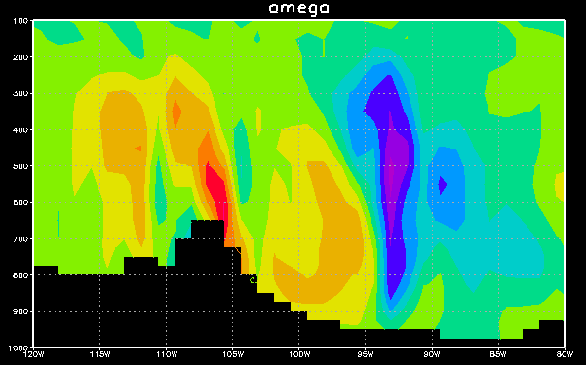
East-west section: omega
→ Z Trof
in order
to create the
needed
cool core
(low ΔZ),
so balance
can again prevail
…

Slide 40
Warm horizontal advection demands even more upward motion, if the cool core is to be built
TROF
cool air flowing south
warm air flowing north
warm air flowing north

Slide 41
East-west section: omega
to build
Z Trof
ascent
creates the
needed
cool core
(low ΔZ),
so that balance
can again prevail
…

Slide 42
Vertical motion and clouds

